Slide 1






PROJECT
PRESENTATION
Presented by: Group 24

Slide 2


GROUP MEMBERS
DENZEL ROBIN : 2023BCS0189
RON STEPHEN MATHEW : 2023BCS0192
ADITHYA T J : 2023BCS0195
MUHAMMED MINHAJ P S : 2023BCS0225

Slide 3

PROBLEM STATEMENT
Agriculture plays a critical role in global food production. However, many farmers select crops based on market rather than data.
This leads to:
Low crop yield
Poor soil utilization
Financial losses
Inefficient farming decisions
There is a need for a data-driven recommendation system that can suggest the most suitable crops based on soil and environmental conditions.

Slide 4
PROJECT OBJECTIVE
Build an Intelligent Crop Recommendation System
Use data mining techniques to analyze agricultural data
Recommend crops based on:
Nitrogen
Phosphorus
Potassium
Temperature
Humidity
Soil pH
Rainfall
Provide accurate predictions using machine learning

Slide 5
OUR WORKFLOW
1) Dataset Exploration
2) Data Cleaning and Feature Engineering
3) Training and Testing the Model
4) Testing the backend
5) Creating an API for backend
6) Creating a frontend
7) Connecting frontend and backend
8) Using docker to make the application ready to deploy

Slide 6
DATASET OVERVIEW
Dataset source: Kaggle Crop Recommendation Dataset
Dataset Features
N
P
K
Temperature
Humidity
pH
Rainfall
Label

Slide 7
DATASET OVERVIEW
Total Records: 2200
Number of crops: 22
Features: 7

Slide 8
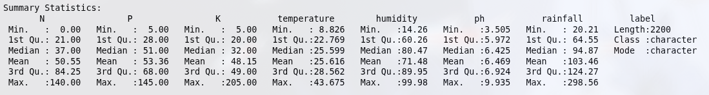
DATASET OVERVIEW

Slide 9
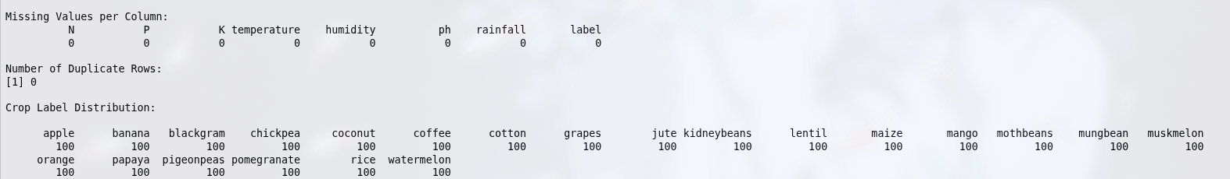
DATASET OVERVIEW

Slide 10
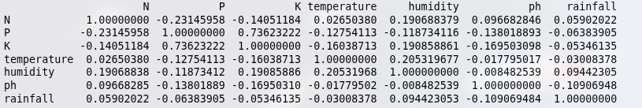
FEATURE CORRELATION
Feature Correlation was done using Pearson Correlation Coefficient between all numerical features.

Slide 11
FEATURE CORRELATION
The correlation matrix shows that most features have low correlation, meaning each variable contributes unique information for crop prediction.

Slide 12
OUTLIER ANALYSIS
Outliers were detected using IQR method.
Outliers observed in:
pH
Phosphorus
Temperature
Rainfall

Slide 13
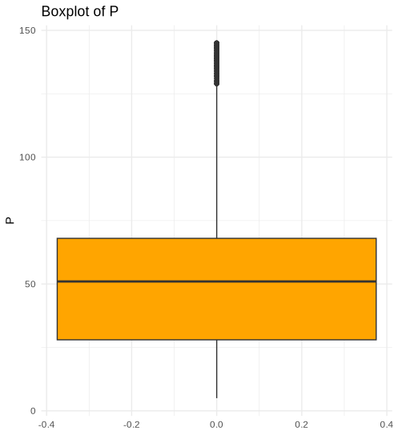

Slide 14
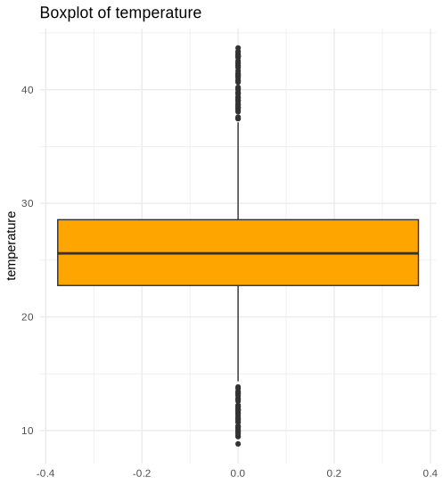

Slide 15
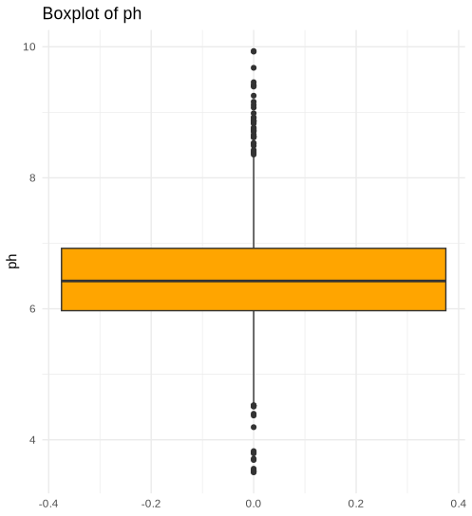

Slide 16
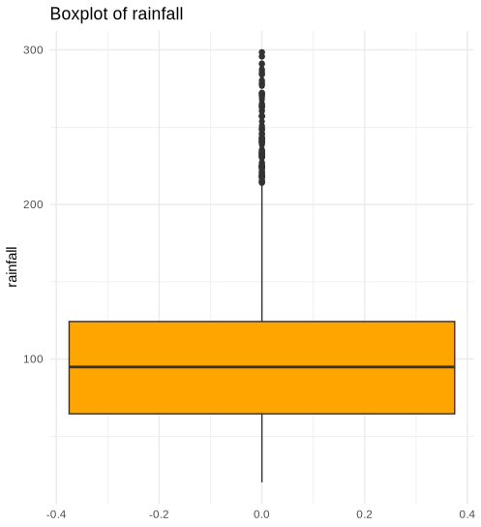

Slide 17
OUTLIER ANALYSIS
However, we did not remove these values because:
They represent valid crop requirements
Removing them would remove crop categories
It would bias the model

Slide 18
DATA CLEANING
After the exploration of dataset, we found
The dataset we got from
https://www.kaggle.com/datasets/atharvaingle/crop-recommendation-dataset
was already cleaned

Slide 19
FEATURE ENGINEERING
We have added
NP_ratio
NK_ratio
PK_ratio
temp_humidity_interaction
rainfall_ph_interaction

Slide 20
TRAIN-TEST SPLITTING
We used stratified sampling to take 80% of data from each label and use them for training.
Rest 20% was used for testing.

Slide 21
MODEL TRAINING
The architecture we used is XGBoost.
The model is trained entirely in R.
The architecture was imported from the library “xgboost”
Steps performed:
Load processed training and testing datasets
Convert data into XGBoost DMatrix format
Define model parameters
Train the model with early stopping
Evaluate performance on test data

Slide 22
WHY XGBOOST
XGBoost is optimized for structured tabular data and can effectively capture relationships between soil nutrients and environmental factors.
XGBoost learns complex nonlinear relationships between soil nutrients, climate variables, and crop types.
XGBoost improves accuracy by combining multiple decision trees using gradient boosting.

Slide 23
WHY XGBOOST
XGBoost trains multiple decision trees sequentially, where each tree corrects the errors of the previous one.
Tree-based models are robust to outliers, making them suitable for agricultural datasets with extreme environmental conditions.

Slide 24
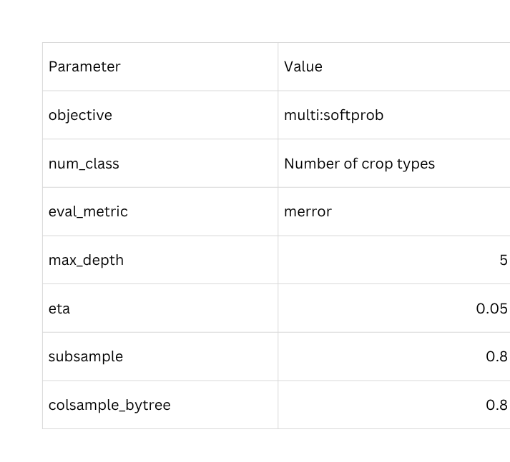
MODEL HYPERPARAMETERS

Slide 25
MODEL TESTING
Merror is the metric used for model testing.
What it counts?
Every sample where the predicted crop label does not match the true label.
We also used early stopping(50 rounds) while training, merror is very suitable for early stopping to function properly

Slide 26
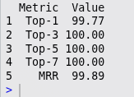
MODEL TESTING
We evaluate the model based on how highly the correct crop appears in the recommendation list.

Slide 27
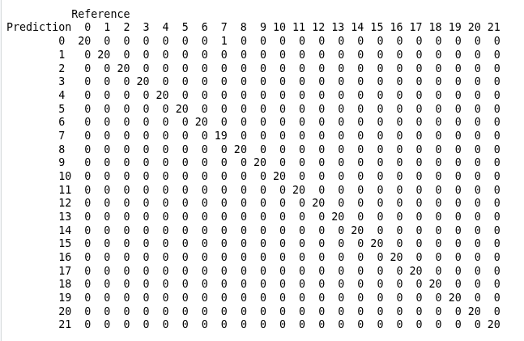
CONFUSION MATRIX

Slide 28
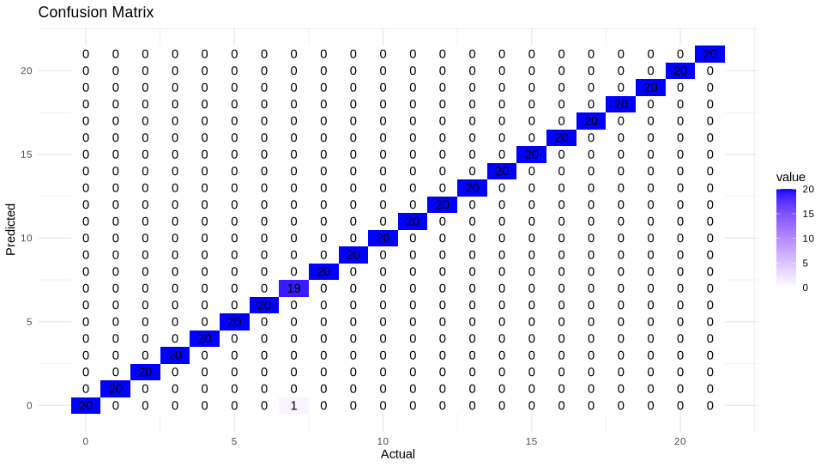
CONFUSION MATRIX

Slide 29
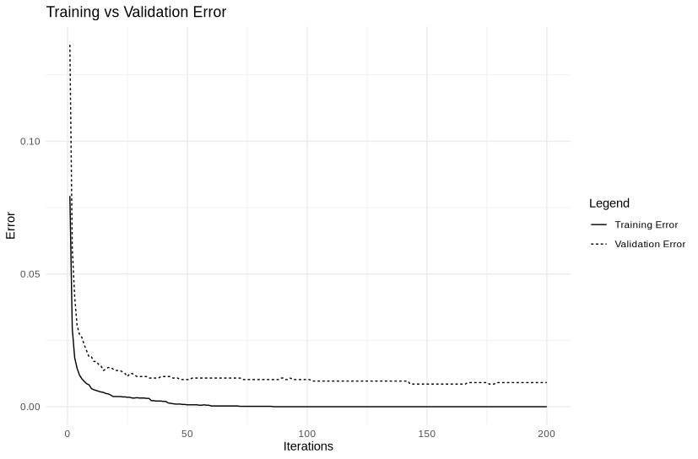
TRAINING VS VALIDATION

Slide 30
API CREATION
In order to use the ML model trained in R, we need an API.
There is a library in R, called “plumber”. Plumber can make an API for RScript. This API can be used on web application connecting frontend and backend.

Slide 31
SYSTEM IMPLEMENTATION
Components of the system:
Backend
Developed in R
Model trained in XGBoost architecture
API
Created using plumber library in R
Frontend
Developed with React + Javascript + Tailwind CSS

Slide 32
APPLICATION DEMO

Slide 33
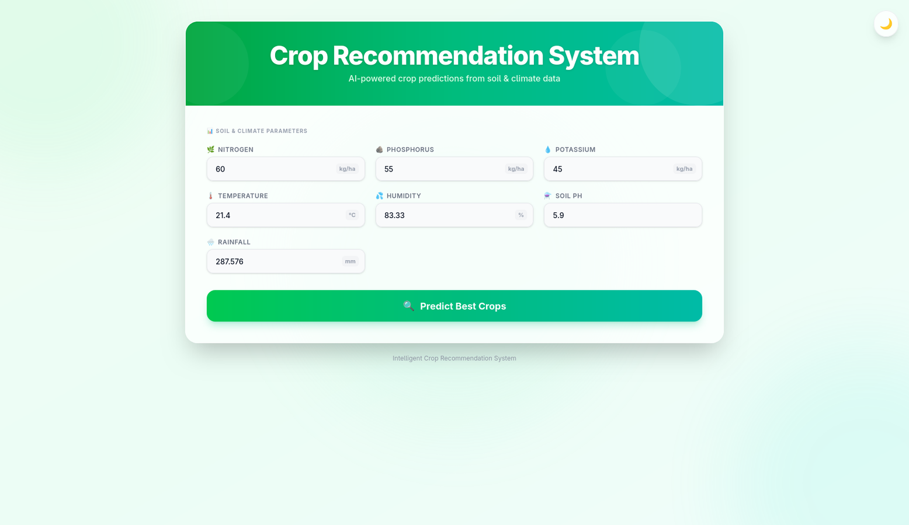

Slide 34
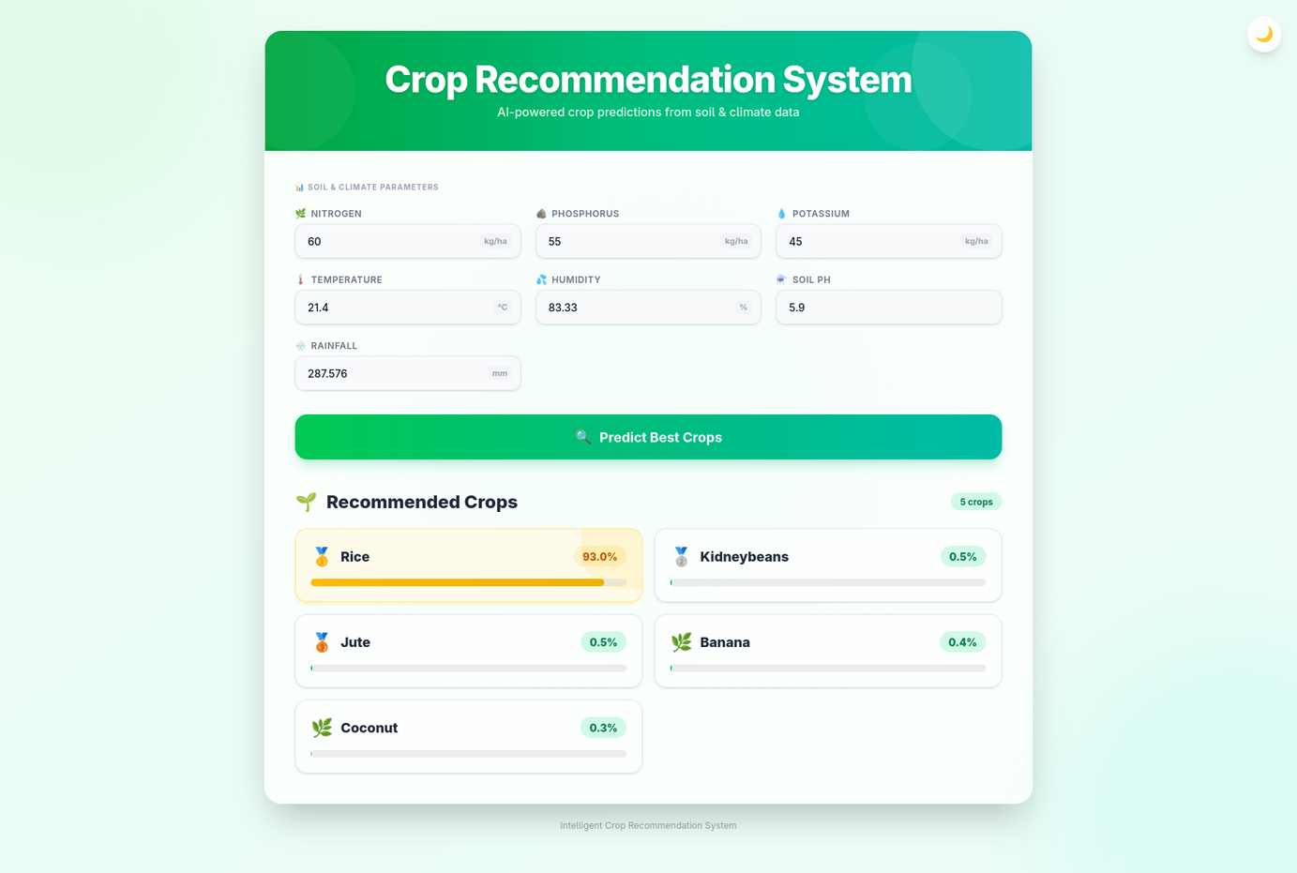

Slide 35
RESULTS
Implemented data driven crop selection
Quick response from ML model
Helps farmers make smart cultivation decisions

Slide 36
CONCLUSION
The Intelligent Crop Recommendation System demonstrates how data mining techniques can be applied to agriculture.
By analyzing soil nutrients and environmental conditions, the system provides accurate crop recommendations that can help farmers make better decisions and improve agricultural productivity.

Slide 37

THANK YOU

